Slide 1
Faster!
Profiling CUDA applications
Supervisor: WONG Weng Fai
Student: Shen Zongyi
Notes:
Hi dear professors, this is my presentation for the project.
I am Shen Zongyi and my supervisor is Wong Weng-fai.

Slide 2
Want to profile a CUDA application?
Nsight
Good, but not so good
Nvprof
Complex dynamic behavior!
Threads in different blocks run asynchronously!
These tools can only capture the overall behavior of an application or kernel.
Any other choice?
Notes:
What tools are there when we want to profile a CUDA application?
NVIDIA provides two profiling tools, they are Nsight and Nvprof. They are good and very easy to use, but there are still some places that can be improved.
The massively-parallel nature of GPUs may produce complex dynamic behavior resulting in reduced throughput even with simple applications.
Warps are interleaved in a fine-grained multithreaded manner and threads in different blocks run asynchronously with each other.
Miss optimization opportunities that underlie the complex dynamic behaviors possible on such a system.

Slide 3
cycle-level
GPGPU-Sim
cycle-level
Too slow
software based (can fit different architectures and applications)
high accuracy
Using software to simulate hardware
will of course lead to slow speed.
support CUDA
Notes:
GPGPU-Sim is a cycle-accurate simulator. It can give us the metrics about every sampling period ( 500 cycles by default) in chronological order.
It uses a PTX virtual instruction set to run all the code on device. Everything is run on CPU, and their behaviors will be captured.
It passes carefully designed experiments to verify its accuracy.
It supports CUDA, without changing the application we can use it.
But it is too slow.

Slide 4
GPGPU-Sim
nvprof
We want to combine the advantages of
these two methods and avoid their
disadvantages as much as possible.
Notes:
GPGPU-Sim’s cycle-accurate
nvprof’ speed

Slide 5
work flow
Separate the power model (GPUWattch) from GPGPU-Sim
Let the power model generate the final power report based on the performance counters stored in file.
Use nvprof to generate power metrics of CUDA applications
Transform the power metrics from nvprof to the performance counters which can satisfy GPGPU-Sim’s power model
Change configuration files to make our power model more realistic
Notes:
This is our work flow. Step by step, we want to achieve our purpose.
GPUWattch an energy model based upon McPAT that is integrated with GPGPU-Sim
GPUWattch can be viewed as part of GPGPU-Sim. It is responsible for calculating power and generating power reports.

Slide 6
Separate the power model from GPGPU-Sim
GPGPU-Sim
GPUWattch
GPUWattch
file manually generated
performance counters
performance counters
power report
power report
Notes:
See, this is what GPGPU-Sim does. In GPGPU-Sim, when GPUWattch is called, the performance counters will be transferred to it. It then does the calculation, and gradually generate the final report.
But what we want to achieve now is this: feed GPUWattch the performance counters we set manually. And let it generate the power report.

Slide 7
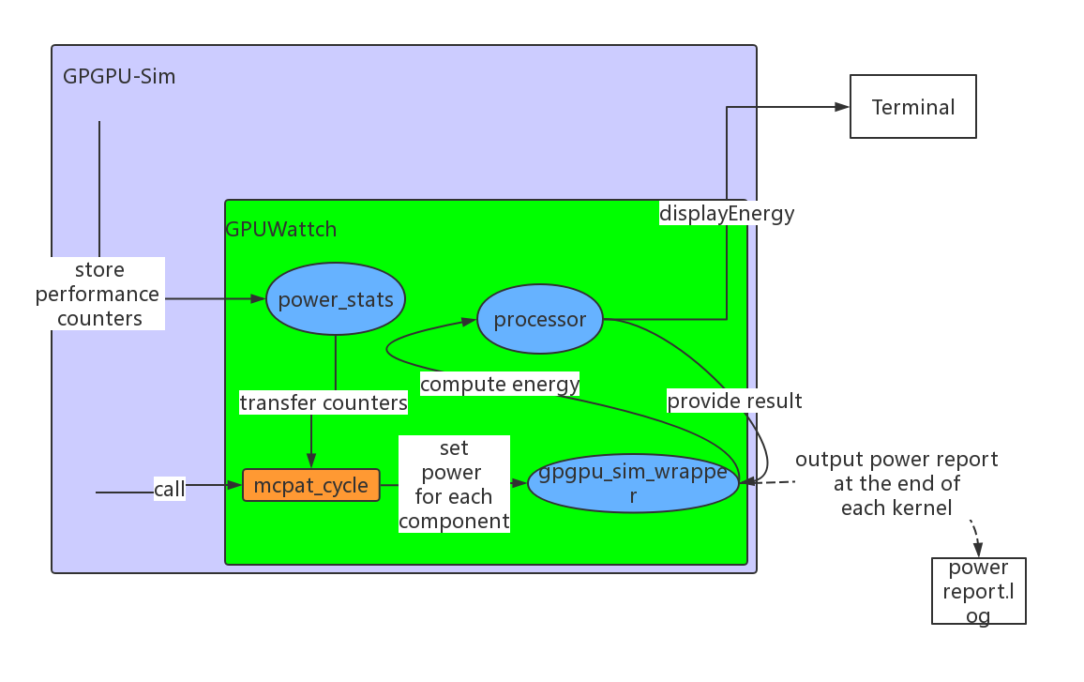
How GPGPU-Sim generates a power report
Notes:
This is the mechanism how GPGPU-Sim generates a power report.

Slide 8
The most important function mcpat_cycle
Every sampling period (500 cycles by default), this function will be activated and calculate
the power for each component. The results will be stored.
The function to generate the power gpgpu_sim_wrapper::print_power_kernel_stats()
At the end of each kernel, this function will be called and generate the power report
based on the data stored by function mcpat_cycle.
There are other useful functions and variables GPUWattch uses…
How can we use these functions in our main code?

Slide 9
First, write a main.cc to use the functions with the same logic as GPGPU-Sim uses.
Make sure if we can use these functions, we will generate a power report.
Third, find a set of object files that
contains all the functions/variables we need
do not rely on other object files or libraries
Second, find a set of
.h files that define the functions and variables we use.
And, include them in our main.cc.
Design the compile command,
include all the .h files in
the –I option and all the .o files
Notes:
First step is to make sure we can generate the power report and its result is meaningful.
But we have to use many functions and variables, if we do not include .h files, our code won’t pass compilation.
After this, note that in these .h files there are also some outside dependencies. If we compile and run the code directly, there are two possible results: 1) compilation failed 2) runtime error
So, we still have to find a set of object files to satisfy our needs. We need these .o files have two features:1.2.
Design the command to compile our code.

Slide 10
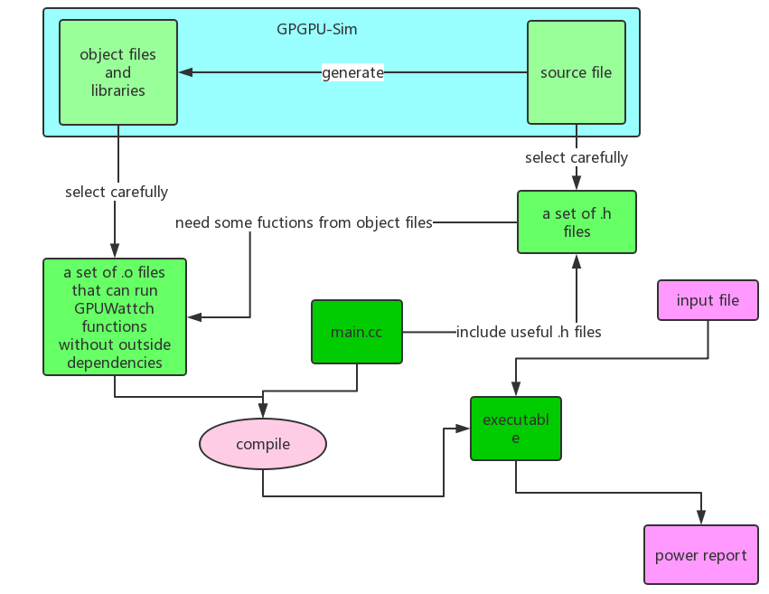
Work flow
Notes:
This is our work flow.
We have to make sure that the .h files have the definition of variables / classes / functions that we use in our main.cc.

Slide 11
2. Let the power model generate the final power report based on the performance counters stored in file.
First, we want to know the format of all performance counters and sample values.
We modified the original mcpat_cycle function to let it output the performance counters during each sampling period.
This is the sample values for all performance counters for one single sampling period.
0 500 18 3 15 4 0 9 512 192 256 7 0 0 0 0 0 0 3 1 0 0 0 0 0 0 14.976000 0.000667 0 0 0 48 2000 264 0.000000 0.000000 0.000000 0.000000
Every performance counter is converted to a digit ( double or integer ).
Every period, GPUWattch will calculate the power for each component based on these data.
If the application exists for N cycles, then the file will have N/500 lines.
So if we give GPUWattch a file that contains all these values and modify the function mcpat_cycle to let it read in data from file, GPUWattch will generate a power report that is the same as the one generated by simulating all the program

Slide 12
But where is the data to feed GPUWattch?
Now we can do this!
GPUWattch
GPGPU-Sim
GPUWattch
file storing performance counters
performance counters
performance counters
power report
We need to simulate the whole application using GPGPU-Sim first?
This is not good. We need another way to generate the data.

Slide 13
3. Use nvprof to generate power metrics of CUDA applications
What will nvprof give us?
It can only give us the metrics of each kernel…
Device | Kernel | Invocations | Metric Name | Metric Description | Avg
TITAN V (0) | executeThirdLayer(float*, float*, float*) | 1 | inst_per_warp | Instructions per warp | 10093.48
What we want is the metrics for each sampling period ( like 500 cycles) ,
but what we have is the metrics for each kernel.
A gap?
Notes:
This is part of the gap between nvprof’ power metrics and GPUWattch performance counters.

Slide 14
Luckily, if we see more about how the power is calculated…
GPGPU-Sim set a constant representing the power for each operation, and the calculation is
the number of each type of operation multiples their according constant.
In each sampling period:
$component^{′}s power=constant ∗(number$ of operations)
This is linear!
We can transfer the performance counters for each kernel to GPUWattch to calculate!
This means that we view that this kernel only has one sampling period to finish.
But actually this is not suitable for evry performance counter. We will encounter problems in the next several slides.
OK, we can transfer the data now… Wait! the metrics from nvprof are not well matched with GPUWattch’s performance counters!

Slide 15
4. Transform the power metrics from nvprof to the performance counters which can satisfy GPGPU-Sim’s power model
The performance counters can be divided into 3 categories…
can be found directly in nvprof’s metrics
Like integer operations, this is included in nvprof’s output
This is good!
can not be found directly, but can be derived from nvprof’s metrics
Like fp operations, this in nvprof is divided into 3 metrics: fp32, fp64, fp16
This is still OK!
3. can neither be found directly or derived…
Like idle cores, nvprof does not offer any information about this…
This is too sad!
Notes:
I will mainly introduce how we deal with the third category of performance counters.
We will set a pre-defined distribution, the average value from original GPGPU-Sim or some other further changes.

Slide 16
To deal with those “missing” performance counters, we have to estimate them as correct as possible
Some important performance counters we transform:
register file read: we set this performance counter as instructions executed * 2
register file write: we set this performance counter as instructions executed * 1
non register file operation: we set this performance counter as instructions executed * 0.25
A normal instruction(MIPS):
Read $t1
Read $t2
Write to $t0
add $t0,$t1,$t2
2 register file read operations
1 register file write operation
Notes:
some performance counters we set a pre-defined distribution

Slide 17
?
div $t5,$t6
addi $t2,$t3, 5
mov $a0, $t2
If we want to estimate the register file operations more accurately,
we have to get the number of different types of assembly instructions.
Now we can not get this.
This may not be correct, but we have to set the number of register file operations
manually based on the instruction number. This is the best method we can take now.

Slide 18
instruction cache hit/miss
constant cache hit/miss
dram precharge access
We set these performance counters as the average number in original GPGPU-Sim
SFU pipeline
Actually in original GPGPU-Sim we scan the performance
counters for each sampling period, these are often 0. Even they
are not 0, they are very small.
Network on chip(SIMT to Mem or Mem to SIMT)
When dealing with the performance counter IDLE CORE, we found we cannot just set it as the average value….
Notes:
The second method we deal with those missing performance counters is that we set them as the average value from original GPGPU-Sim

Slide 19
5. Change configuration files to make our power model more realistic
The architecture GPGPU-Sim use by default is GTX480, which has 480 cores(shown in its official website). In GPGPU-Sim, number of cores is set as 16.
The average number of IDLE CORE is 14.96 for one benchmark we chose.
A huge gap!
The machine on which we use nvprof to get power metrics is TITAN V. It has 5120 cores!
We cannot directly set the performance counter manually!

Slide 20
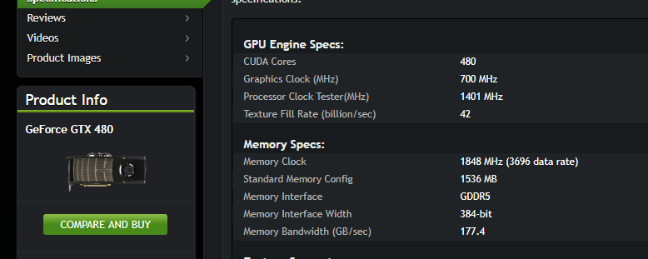
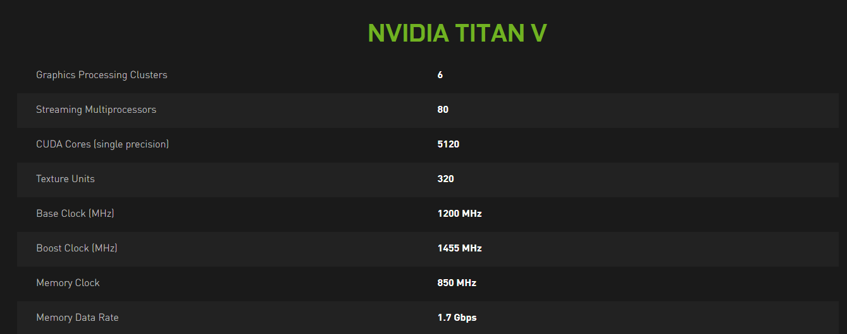
Change the configuration file…
Currently, GPGPU-Sim only supports two architectures(GT200 and Fermi).
We chose Fermi’s configuration as our basic configuration.
We modify the configuration to let it be as close to TITAN V as possible.
Two main parameters we change : number of cores, clockrate

Slide 21
Then, we can generate the power report now!
We chose two benchmarks, Vector Addition (one kernel) and Neural Network (four kernels)
One thing is sure, the speed of our method is much faster…..
Time consumption
Method and benchmark | Time
Our model for Benchmark1 Vector Addition | 17.41s
Original GPGPU-Sim for Benchmark 1 Vector Addition | 113.81s
Our model for Benchmark2 Neural Network | 17.73s
Original GPGPU-Sim for Benchmark2 Neural Network | 274.36s
But at first, the result is not very good.

Slide 22
First, if we just modified the configuration to fit TITAN V architecture,
and run the benchmark Vector Addition using our method…
The kernel power consumed is 8147.61 Watts! This is not realistic.
What if we run this application in original GPGPU-Sim?
The kernel power consumed is 8148.62 Watts! This is also not realistic.
What’s wrong?

Slide 23
Take a look at the components’ power…
total_power | 8148.62
gpu_avg_IBP | 1.55E-06
gpu_avg_ICP | 0.00014247
gpu_avg_DCP | 3.62E-05
gpu_avg_TCP | 0
gpu_avg_CCP | 0.000145638
gpu_avg_SHRDP | 0
gpu_avg_RFP | 0.000472801
gpu_avg_SPP | 0.000305859
gpu_avg_SFUP | 0.00021015
gpu_avg_FPUP | 3.20E-06
gpu_avg_SCHEDP | 2.02E-05
gpu_avg_L2CP | 0.000101538
gpu_avg_MCP | 1.17645
gpu_avg_NOCP | 0.000255935
gpu_avg_DRAMP | 0.00135276
gpu_avg_PIPEP | 0.000427529
gpu_avg_IDLE_COREP | 8137.62
gpu_avg_CONST_DYNAMICP | 9.82366
99.86% of power is consumed by IDLE CORE!
The pre-defined constant(1.59) of power for IDLE CORE may
work well in GTX480, but not in TITAN V…..
After doing some experiments, we set it as 0.0318
Then, our final result is…..

Slide 24
Average power for each kernel
Kernel | Original GPGPU-Sim Power(Watts) | Our Model Power(Watts)
VA | 34.2858 | 26.26844
NN1 | 13.5419 | 26.1201
NN2 | 16.2804 | 26.0994
NN3 | 18.5307 | 26.1031
NN4 | 12.4724 | 26.1167
Seem more reasonable, but an obvious trend is that the estimation of our model is more stable.
Actually I have not figured out why there is this trend, maybe just for these two benchmarks…
But there is a direction to spend efforts :
modify the constants of power for each operation for different architectures!
But in our project, this step has not been finished yet.

Slide 25
Limitations
Actually there are some limitations in our method….
We have to set some performance counters using the average number from original GPGPU-Sim, which means we have to simulate the application by GPGPU-Sim first…
Our result is not very accurate, this is likely to be overcome by modifying the configuration parameters.
Our transformation from nvprof’s metrics to GPGPU-Sim’s performance counters like register file operations are fixed, but different applications may have different distributions of different types of instructions.
But this is a novel way to profile CUDA applications. What if we can derive the performance counters from users’ source code? What if nvprof in the future provides more detailed metrics such that the number of mov/add/… instructions?
Notes:
Though our method has many limitations, it provides many possibilities.

Slide 26
Just as one of the inventors of GPGPU-Sim says:
The intention of GPGPU-Sim is to provide a substrate for architecture research rather than to exactly model any particular commercial GPU.
The intention of our method is to add more possibilities to this substrate rather than
to exactly model any particular commercial GPU or application.
Even with these limitations, it still enables users to generate the power report faster than GPGPU-Sim,
if we do not require high accuracy or just focus on some components, we can still find insights to optimize CUDA applications.
It is a trade off between accuracy and speed.

Slide 27
Thanks for listening!
GPGPU-Sim
nvprof

